Slide 1
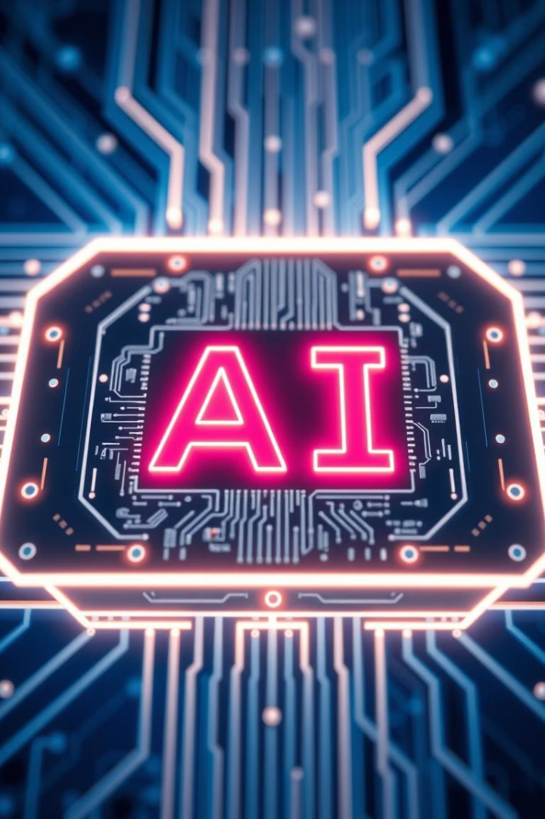
Introduction to Artificial Intelligence (AI)
Exploring the basics of AI technology and its impact.

Slide 2
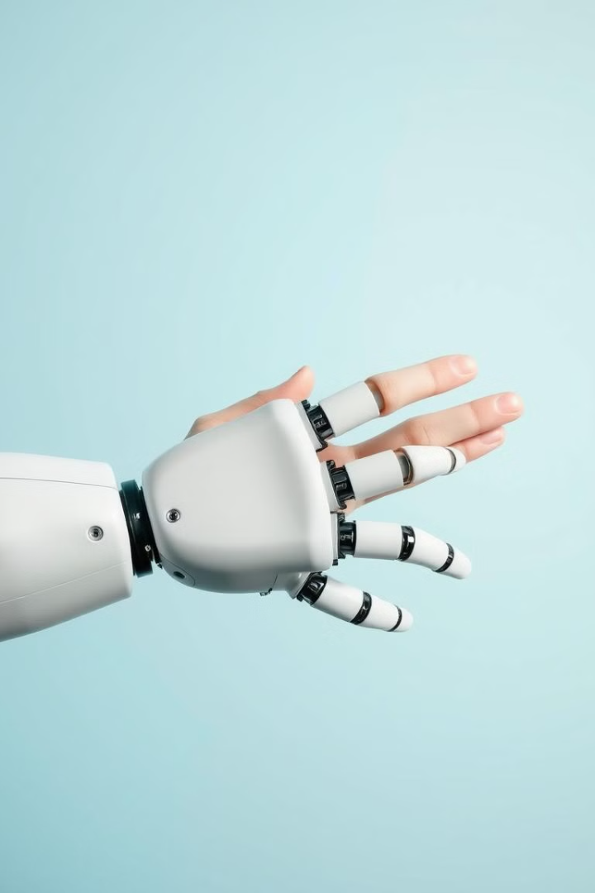
What is AI?
Intelligence Simulation
Machines programmed to mimic human thinking.
Task Performance
Enables complex problem-solving and decision-making.
Continuous Learning
Improves performance through data and experience.

Slide 3

Types of AI
1
Narrow AI
It's designed to perform a specific task,like recognizing
faces, playing chess, or recommending songs.
2
General AI
This is the kind of AI that can think and learn like a human. It would be able to understand, learn, and apply knowledge across different tasks, not just one.
3
Super AI
smarter than all humans combined. Superfast in all aspects
like creativity, problem-solving, emotions, and more.

Slide 4






Key Concepts in AI
Machine Learning
Natural Language Processing
Computer Vision
Robotics
Self-improving algorithms through data analysis.
Interpreting and analyzing visual information.
AI-powered machines for physical tasks.
Enabling machines to understand human language.

Slide 5
Applications of AI
Healthcare
Finance
Transportation
AI-assisted diagnoses and personalized treatment plans.
Algorithmic trading and fraud detection systems.
Autonomous vehicles and smart traffic management.

Slide 6
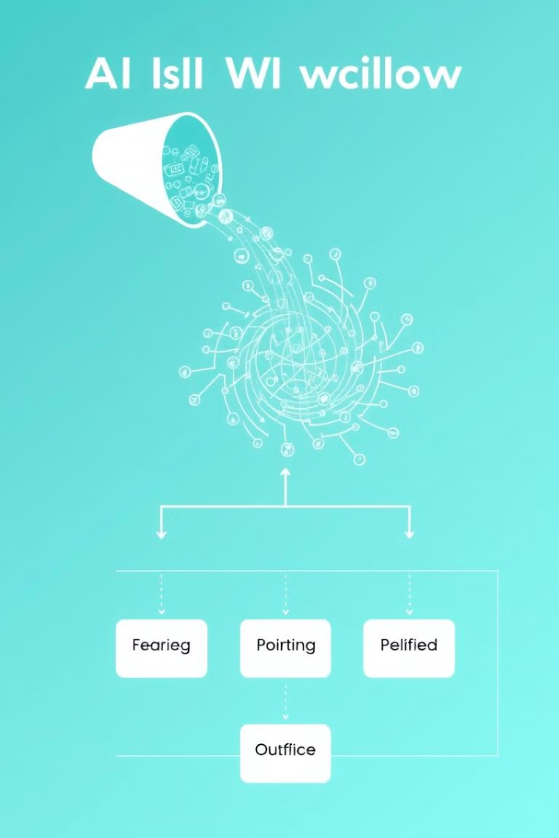




How AI Works
Data Collection
Gathering diverse, high-quality datasets.
Algorithm Design
Creating mathematical models for learning.
Training
Iterative process of model improvement.
Inference
Applying learned knowledge to new situations.

Slide 7

Benefits of AI
1
Enhanced Productivity
Automating repetitive tasks across industries.
2
Data Processing Power
Analyzing vast datasets at unprecedented speeds.
3
Decision Support
Providing insights for complex problem-solving.

Slide 8
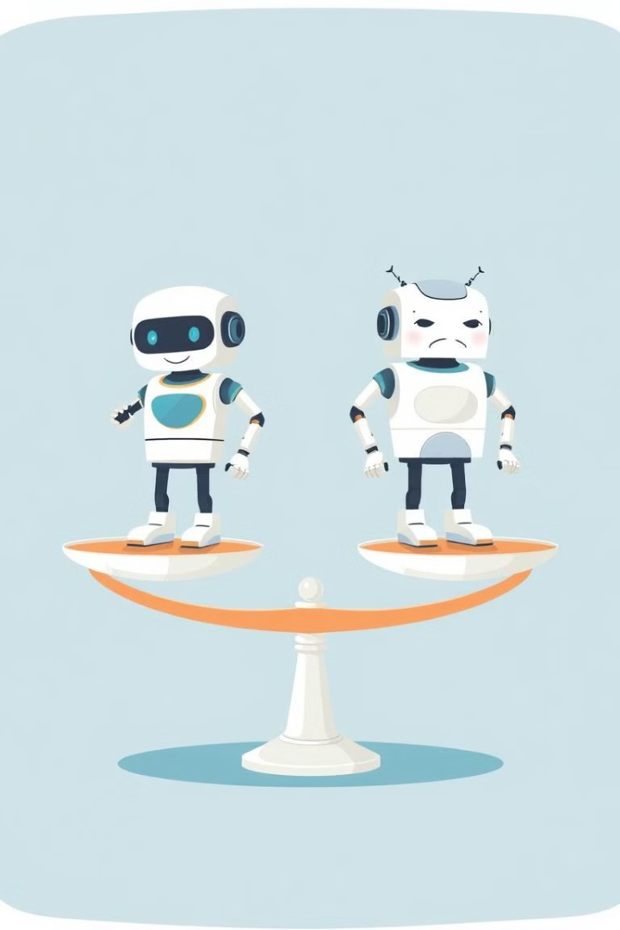
Challenges and Risks
Job Market Disruption
Ethical Dilemmas
Data Privacy Concerns
AI Bias
Security Vulnerabilities
Lack of Transparency

Slide 9

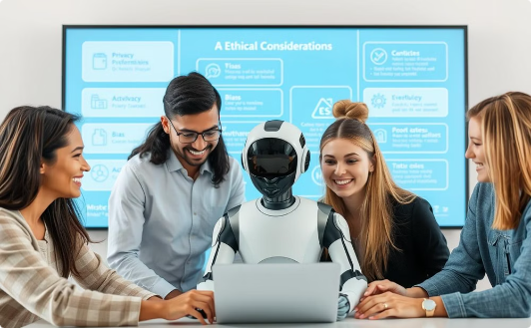
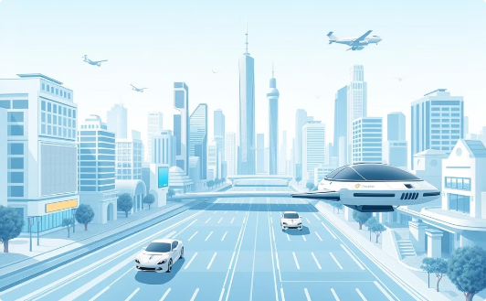
Future of AI
AI in Daily Life
Ethical AI Development
Advanced AI Research
Seamless integration of AI in homes and workplaces.
Ensuring fairness and accountability in AI systems.
Pushing boundaries towards more sophisticated AI capabilities.

Slide 10

Conclusion
Transformative Technology
AI reshaping industries and everyday life.
Continuous Learning
Importance of staying informed about AI developments.
Responsible Innovation
Balancing progress with ethical considerations.

Slide 11

Q&A and discussion
Let's discuss the potential and implications of AI.
1.Can you name one common application of AI?
2.How does AI help in everyday tasks?
3.Why is data important for AI?

